Slide 1
CS5590 Applied Programming Series
Web/Cloud/Mobile Programming

Slide 2
REST APIs with AngularJS
services, $http and calling APIs

Slide 3

Overview
AngularJS Services
$location
$http
AngularJS - $http
AJAX calls via the $http service.
JSONP calls via the $http service.
REST calls via the $http service.
Requirements to access APIs
Source: https://docs.angularjs.org/guide

Slide 4
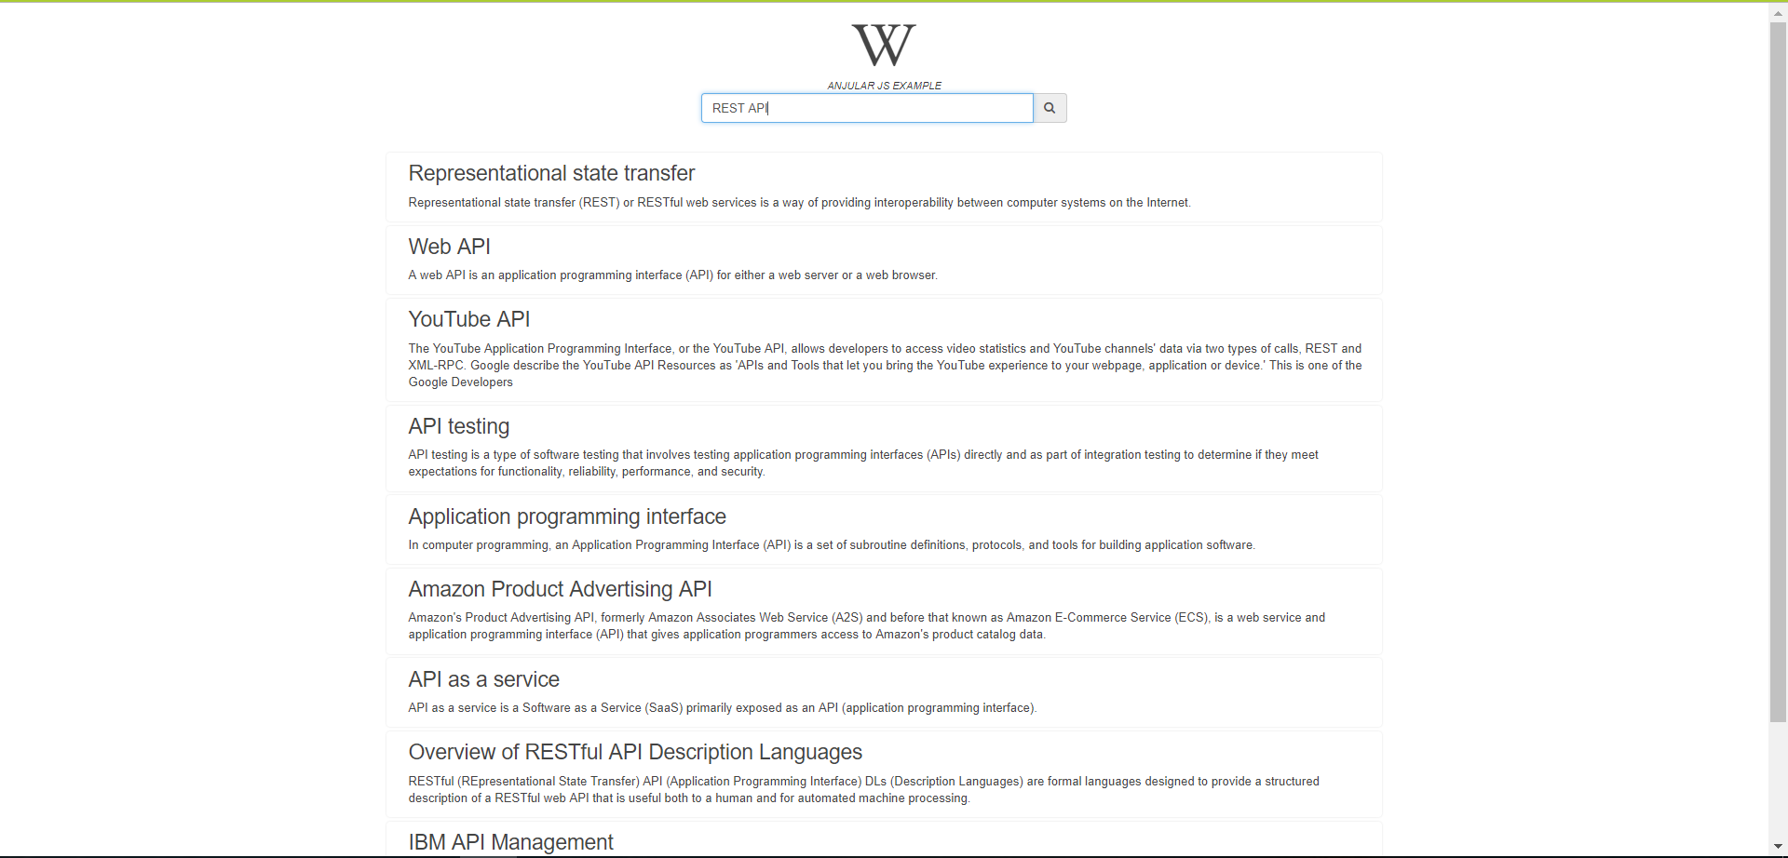
Use Case
Wikipedia Viewer: A sample webpage which extracts data from Wikipedia and displays it to the user based on request with the help of REST call
Source: https://docs.angularjs.org/guide

Slide 5
AngularJS Services
In AngularJS you can make your own service, or use one of the many built-in services.
A service is a function, or object, that is available for, and limited to, your AngularJS application.
AngularJS has about 30 built-in services. One of them is the $location service.
The $location service has methods which return information about the location of the current web page
$location.absUrl();
Source: https://docs.angularjs.org/guide

Slide 6
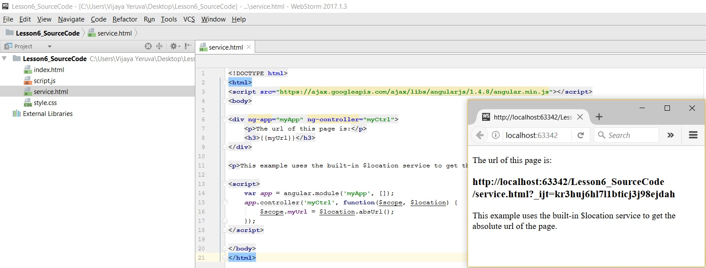
AngularJS - $location
Source: https://docs.angularjs.org/guide

Slide 7
AngularJS - $http
$http is an AngularJS service for reading data from remote servers.
The $http service makes a request to the server, and returns a response.
In AngularJS you can send requests in several different ways.
AJAX calls via the $http service.
JSONP calls via the $http service.
REST calls via the $http service.
Source: https://docs.angularjs.org/guide

Slide 8
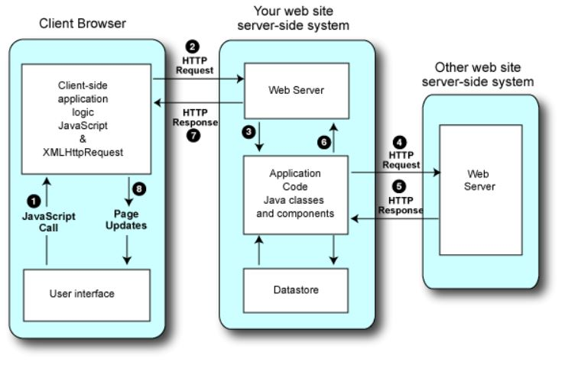
AngularJS - $http
Server-side style mashup
Source: https://docs.angularjs.org/guide

Slide 9
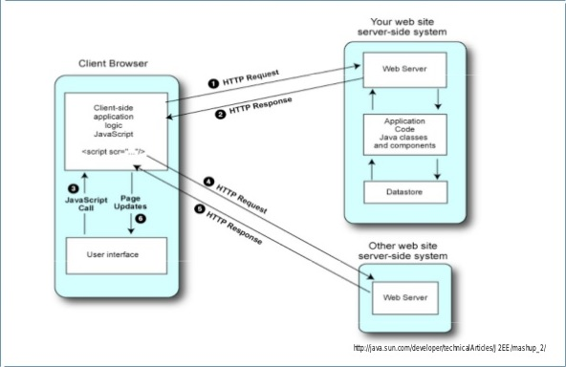
AngularJS - $http
Client-side (In-Brower) mashup
Source: https://docs.angularjs.org/guide

Slide 10
AngularJS AJAX - $http
AJAX – Asynchronous JavaScript and XML is the art of exchanging data with a server, and updating parts of a web page - without reloading the whole page.
Source: https://docs.angularjs.org/guide

Slide 11
$http methods
The $http service has several functions you can use to send AJAX requests. These are:
$http.get(url, config)
$http.post(url, data, config)
$http.put(url, data, config)
$http.delete(url, config)
$http.head(url, config)
Source: https://docs.angularjs.org/guide

Slide 12
Usage
$http({
url: “Url to request”,
method: "get/post/put/delete/head",
data: “The data needed to be sent to server”,
}).success(function(data, status, headers, config) {
“code to run if request succeeds: the response is passed to function”,
}).error(function(data, status, headers, config) {
“code to run if request fails”
});
Source: https://docs.angularjs.org/guide

Slide 13
AngularJS JSON - $http
The data you get from the response is expected to be in JSON format.
JSON is a great way of transporting data, and it is easy to use within AngularJS, or any other JavaScript.
Source: https://docs.angularjs.org/guide

Slide 14
AngularJS - REST Services
Architectural style that specifies certain constraints for communication over web.
It constraints an architecture to a client/server architecture designed to use a stateless communication protocol, typically HTTP.
Clients and servers exchange representations of resources by using a standardized interface and protocol.
Source: https://docs.angularjs.org/guide

Slide 15
REST Operations
Get Retrieves the current state of a resource
Post Updates the state of an existing resource
Put Creates a new resource
Delete Deletes some info
Source: https://docs.angularjs.org/guide

Slide 16
What is needed to Access API ?
Some applications do not require key
Wikipedia application does not require the API key to access the data
Some applications require key
Four Square Tips(Reviews) API requires the API key to access the data
You can get an API key from Developers Service Provider Site
Source: https://docs.angularjs.org/guide

Slide 17
Four Square Venue Details API
Go to https://foursquare.com/
Get Venues: https://api.foursquare.com/v2/venues/search
HTTP Method: GET
Parameters:
VENUE_ID XXX123YYYY #required ID of venue to retrieve
Response: id, name and location etc.
Source: https://docs.angularjs.org/guide

Slide 18
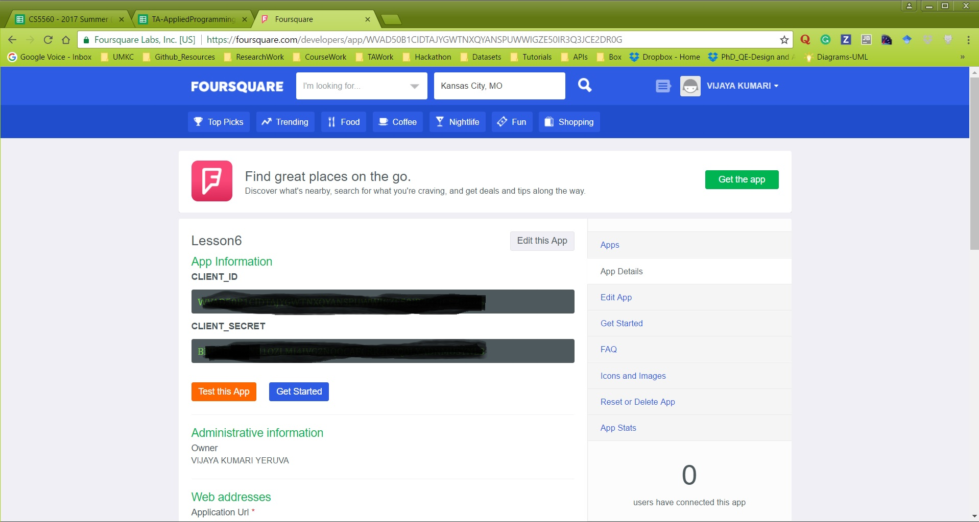
Four Square Tips(Reviews) API
Source: https://docs.angularjs.org/guide

Slide 19
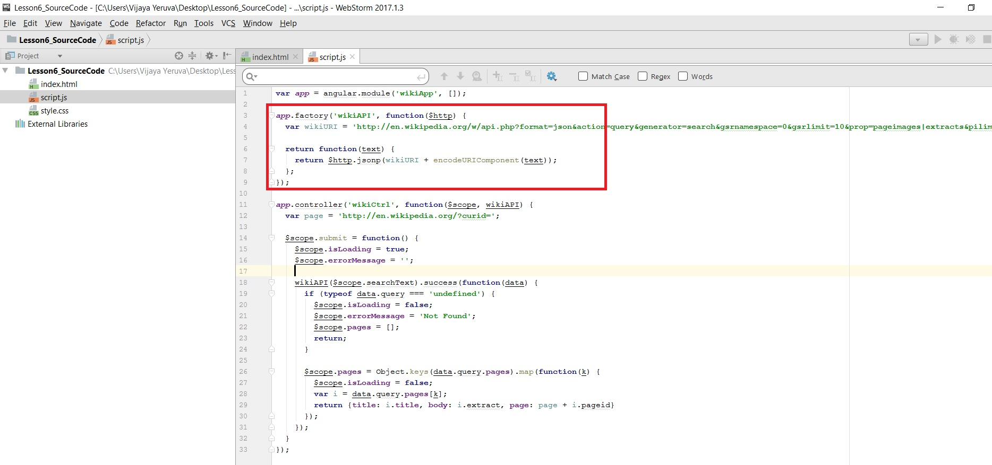
WIKI API
Source: https://docs.angularjs.org/guide

Slide 20
References
https://www.w3schools.com/angular/default.asp
https://docs.angularjs.org/guide
https://en.wikipedia.org/wiki/AngularJS
http://www.restapitutorial.com/lessons/whatisrest.html

Slide 21
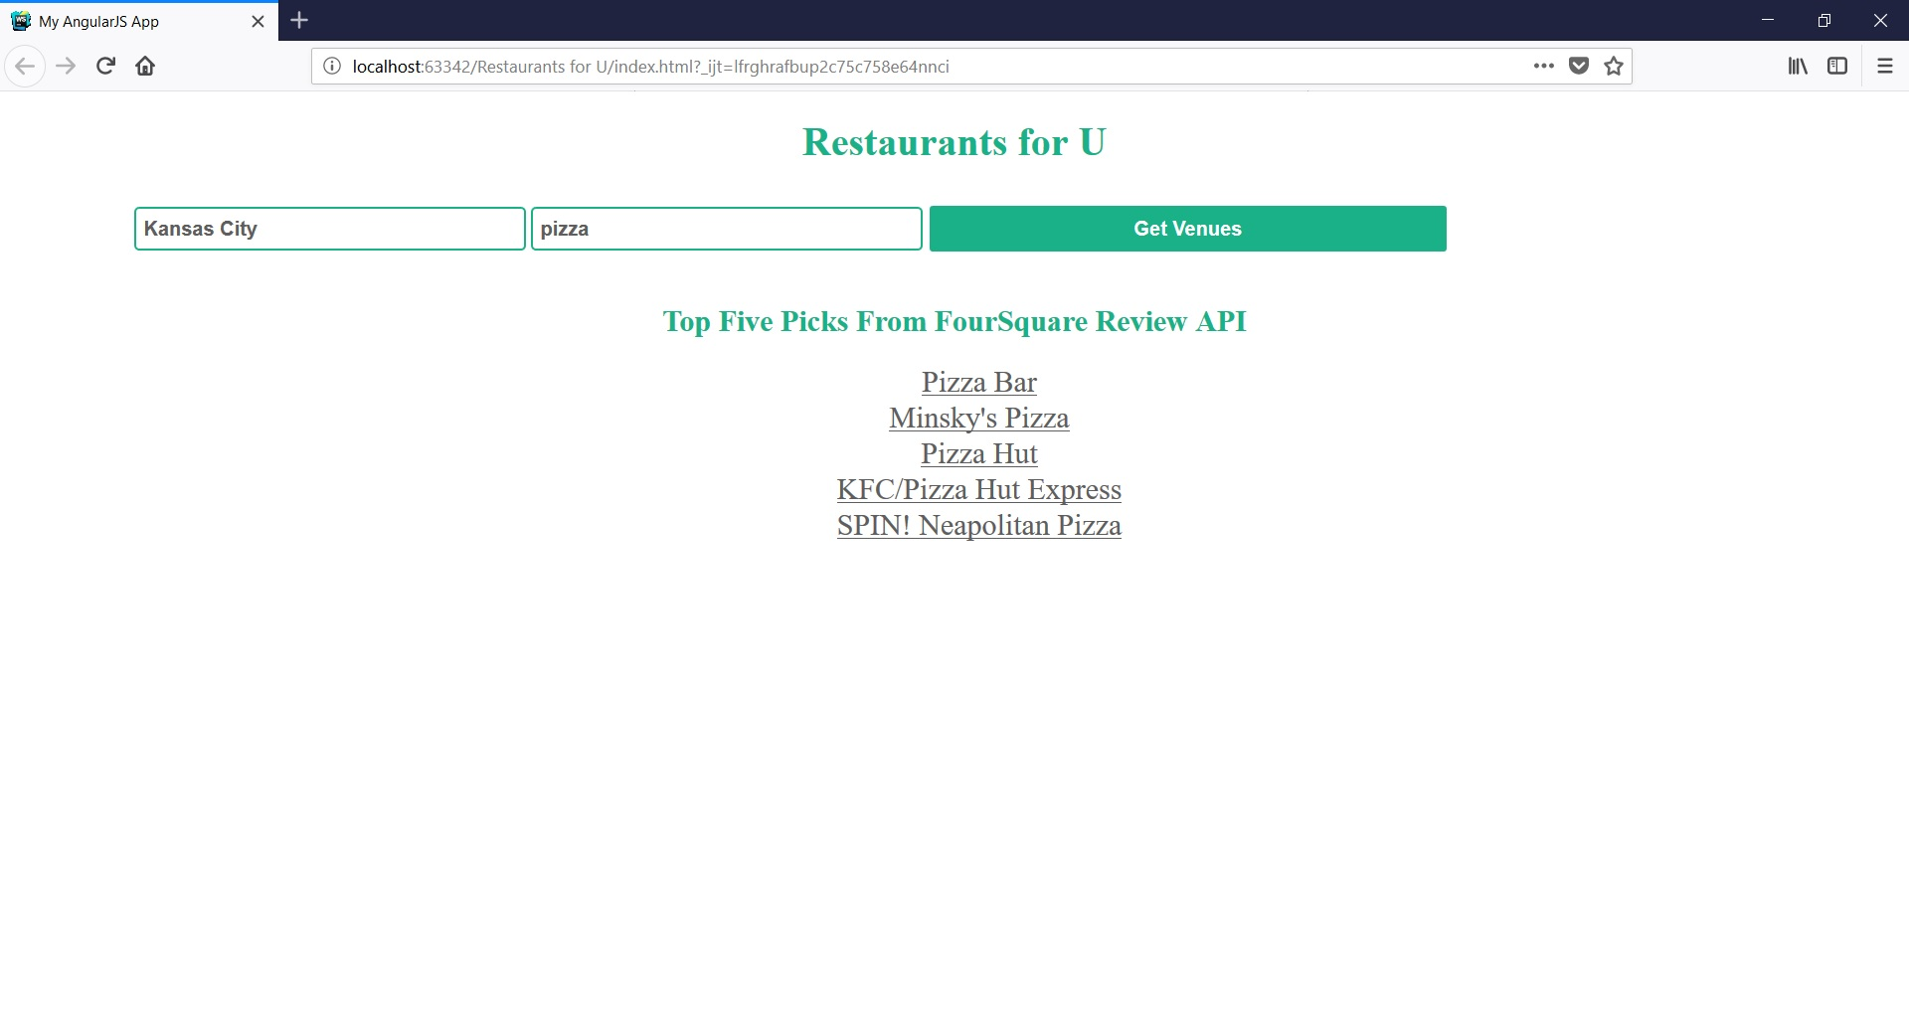
In Class Exercise
Restaurants for U
Create an application which displays nearby restaurants (Hint: Use Four Square API)

Slide 22
Feedback
Please don't forget to submit your feedback after the class. This helps a lot in increasing effectiveness of the course.
Use following link to submit your feedback: https://goo.gl/forms/YKYg28wsHo7OnOa13

